Slide 1
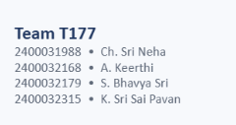
AZURE BATCH FOR AN
ENGINEERING SIMULATION WORKLOAD
Cloud-based parallel processing prototype
Institution
Koneru Lakshmaiah Education Foundation (KLEF)
Department of Computer Science and Engineering
Azure for Students • Azure Batch • 300 simulation tasks

Slide 2
1. Introduction
Why cloud batch processing is useful for engineering workloads
• Engineering simulations often require many independent runs with different input parameters.
• Running a large set of independent calculations on a single machine can be time-consuming.
• Azure Batch provides a managed way to create compute pools, jobs and tasks, and schedule those tasks across compute nodes.
• This project demonstrates the workflow using a controlled numerical simulation workload.
Azure Batch for an Engineering Simulation Workload
2

Slide 3
2. Problem Statement
Engineering Workload
Processing Challenge
Cloud Approach
A simulation study may require hundreds of independent scenarios or parameter combinations.
Sequential execution can increase turnaround time and makes scaling difficult.
Use Azure Batch to schedule many independent tasks over a small pool of compute nodes.
Azure Batch for an Engineering Simulation Workload
3

Slide 4
3. Project Objective
The implementation objective
• Create an Azure Batch account and a compute pool.
• Create a Batch job for the simulation workload.
• Generate and submit 300 independent simulation tasks.
• Monitor task execution and verify completion.
• Demonstrate how the same pattern can support larger engineering simulation studies.
Azure Batch for an Engineering Simulation Workload
4

Slide 5
4. Engineering Use Case / Prototype
Standalone conceptual prototype: Simflow Workload
Inputs
Scenarios
Processing
Results
Number of simulations according to users use
300 independent
simulation cases
Numerical simulation
for each case
Completion of the jobs as per given
Azure Batch for an Engineering Simulation Workload
5

Slide 6
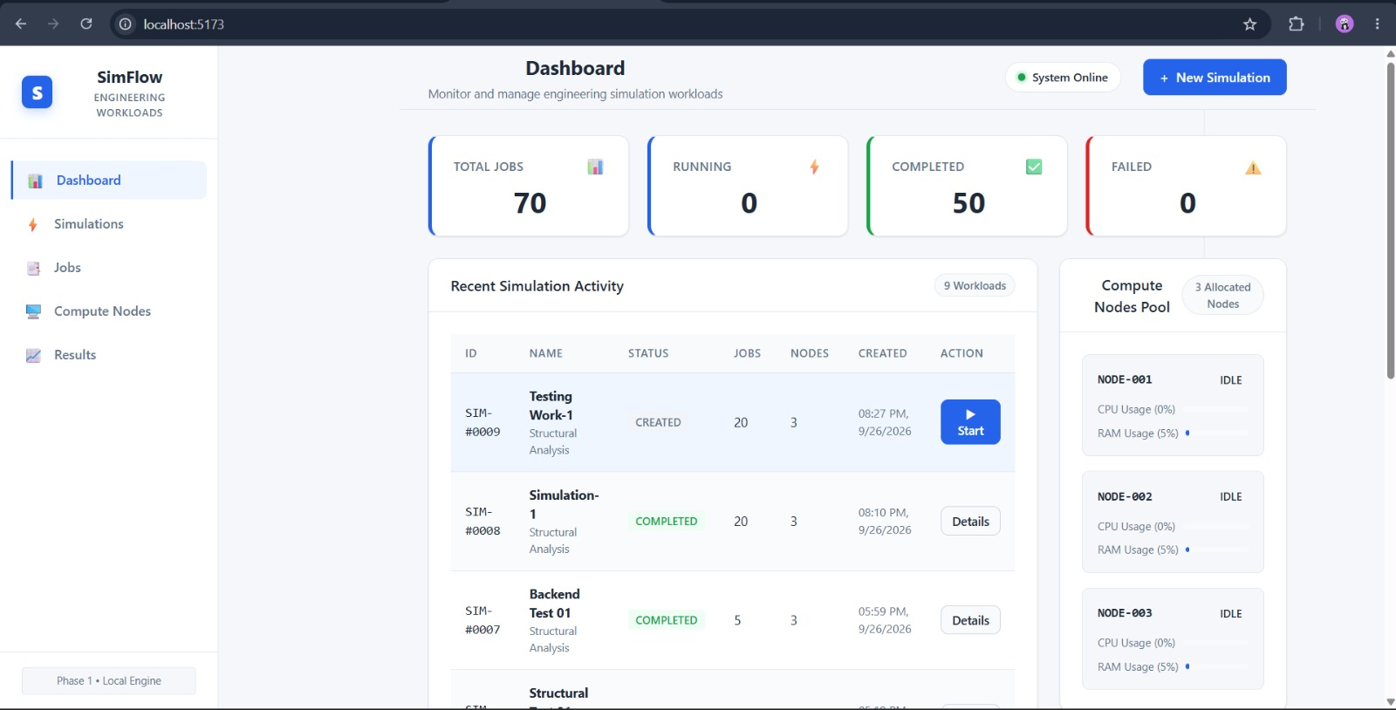
Prototype Simulation
Actual pool used for the workload
simulation-pool: 2 dedicated nodes • 4 vCPUs total • Standard_D2s_v3 • Steady
Azure Batch for an Engineering Simulation Workload
9

Slide 7
5. Proposed Azure Architecture
Azure Portal /
Cloud Shell
Azure Batch
Account
Compute Pool
Batch Job
300 Tasks
Create and manage resources
engsimbatch2026neha
simulation-pool
2 × Standard_D2s_v3
simulation-job
simulation-task-001 … 300
Azure Batch for an Engineering Simulation Workload
6

Slide 8
6. Azure Resources Used
Subscription
Resource Group
Batch Account
Azure for Students
RG-Engineering-Simulation
engsimbatch2026neha
Region
Pool
VM Size
India South Central
simulation-pool
Standard_D2s_v3
Dedicated Nodes
Batch Job
Tasks
2
simulation-job
300
Azure Batch for an Engineering Simulation Workload
7

Slide 9
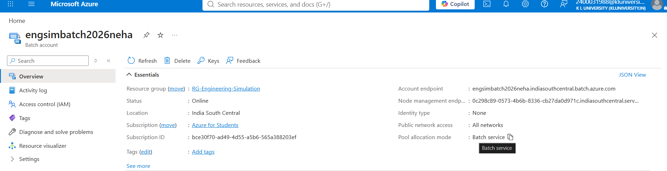
7. Azure Batch Account
Actual Azure implementation
Batch account overview captured in Azure Portal
Azure Batch for an Engineering Simulation Workload
8

Slide 10
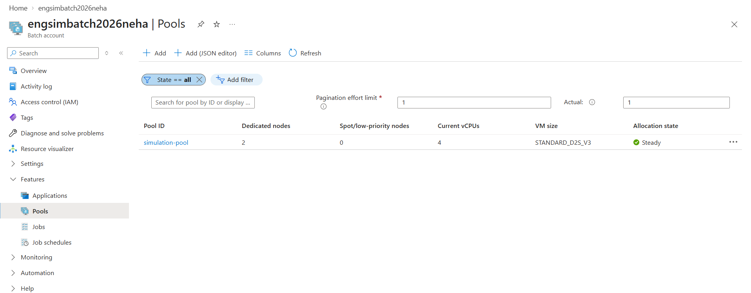
8. Compute Pool Configuration
Actual pool used for the workload
simulation-pool: 2 dedicated nodes • 4 vCPUs total • Standard_D2s_v3 • Steady
Azure Batch for an Engineering Simulation Workload
9

Slide 11
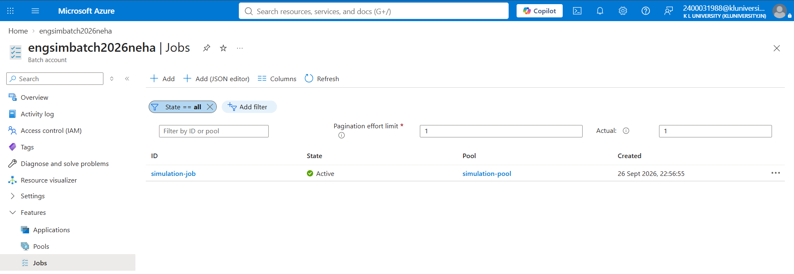
9. Batch Job
Actual job created in the Batch account
simulation-job • Active • linked to simulation-pool
Azure Batch for an Engineering Simulation Workload
10

Slide 12
10. Task Submission
300 independent simulation tasks
Task Range
Workload
Scheduling
simulation-task-001
through
simulation-task-300
Repeated numerical calculations
performed independently per task
Azure Batch places queued tasks
onto available compute nodes
• Tasks were submitted in three batches of 100 tasks.
• Each task used a non-admin task identity on the Ubuntu compute nodes.
• Two dedicated nodes were used to keep the educational demonstration small and cost-conscious.
Azure Batch for an Engineering Simulation Workload
11

Slide 13
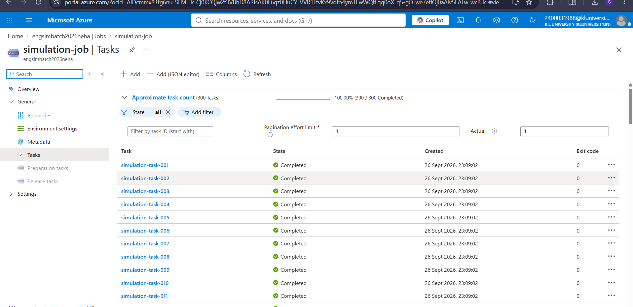
11. Execution Monitoring
Azure Portal shows the workload progressing through Batch
Azure Batch task list: 300 tasks, 100% completed
Azure Batch for an Engineering Simulation Workload
12

Slide 14
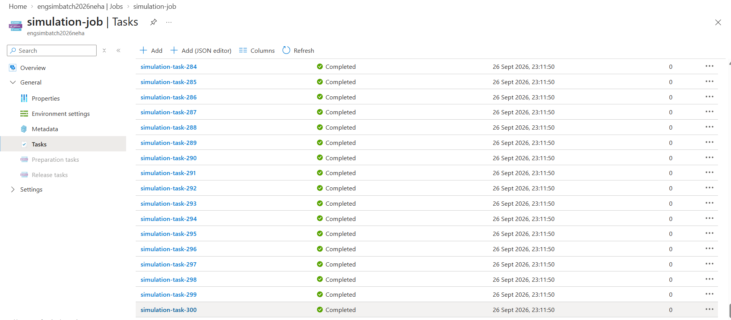
12. Final Task Results
Completion and exit-code evidence
Tasks 284–300 shown as Completed with exit code 0
Result
The displayed final tasks completed successfully (exit code 0).
Azure Batch for an Engineering Simulation Workload
13

Slide 15
13. Final Outcome
What the Azure implementation demonstrated
300
2
100%
0
Simulation tasks submitted
Dedicated compute nodes
Completed tasks shown in Azure
Exit code for the
displayed final tasks
Azure Batch for an Engineering Simulation Workload
14

Slide 16
14. Prototype and Azure Implementation
Kept separate according to the project scope
Prototype
Azure Implementation
• Demonstrates the engineering application concept
• Example: Simflow Workload
• Shows inputs, scenarios, processing and results
• Does not need to connect to Azure
• Demonstrates cloud batch processing
• Azure Batch account + compute pool
• Batch job + 300 independent tasks
• Monitoring and completion verification
Azure Batch for an Engineering Simulation Workload
15

Slide 17
15. Advantages and Applications
• Parallel task execution: independent simulation cases can be scheduled across compute nodes.
• Scalability: the same Batch pattern can be expanded by increasing compute resources when appropriate.
• Managed scheduling: Azure Batch handles task queuing and assignment to available nodes.
• Potential applications include structural analysis, thermal simulations, manufacturing parameter sweeps, aerospace studies and other independent numerical workloads.
Azure Batch for an Engineering Simulation Workload
16

Slide 18
16. Limitations and Cost Considerations
Limitations
Cost / Resource Approach
• The numerical workload is a demonstration workload, not a production engineering solver.
• The prototype and Azure implementation are separate.
• Results from the demonstration should not be interpreted as physical engineering predictions.
• Azure for Students subscription was used.
• A small two-node pool was selected instead of hundreds of nodes.
• The configuration was sufficient to demonstrate Batch scheduling while limiting resource usage.
Azure Batch for an Engineering Simulation Workload
17

Slide 19
17. Conclusion
Project summary
• An Azure Batch environment was created for an engineering simulation workload.
• A compute pool with two Standard_D2s_v3 nodes was configured.
• A Batch job was created and populated with 300 independent tasks.
• Azure Portal evidence shows 300 tasks at 100% completion, with the displayed final tasks returning exit code 0.
• The project demonstrates the basic cloud workflow for scaling independent simulation computations.
Azure Batch for an Engineering Simulation Workload
18

Slide 20
18. Future Scope
• Replace the demonstration numerical workload with a validated engineering simulation solver.
• Use realistic engineering input files and parameter sets for each scenario.
• Collect task outputs into Azure Storage for centralized result analysis.
• Experiment with larger pools and autoscaling for larger workloads.
• Connect the standalone prototype to the cloud workflow if future project scope requires integration.
Azure Batch for an Engineering Simulation Workload
19

Slide 21
THANK YOU
Institution
Koneru Lakshmaiah Education Foundation (KLEF)
Department of Computer Science and Engineering

